Slide 1
Join the Elevate Rewards program

Slide 2
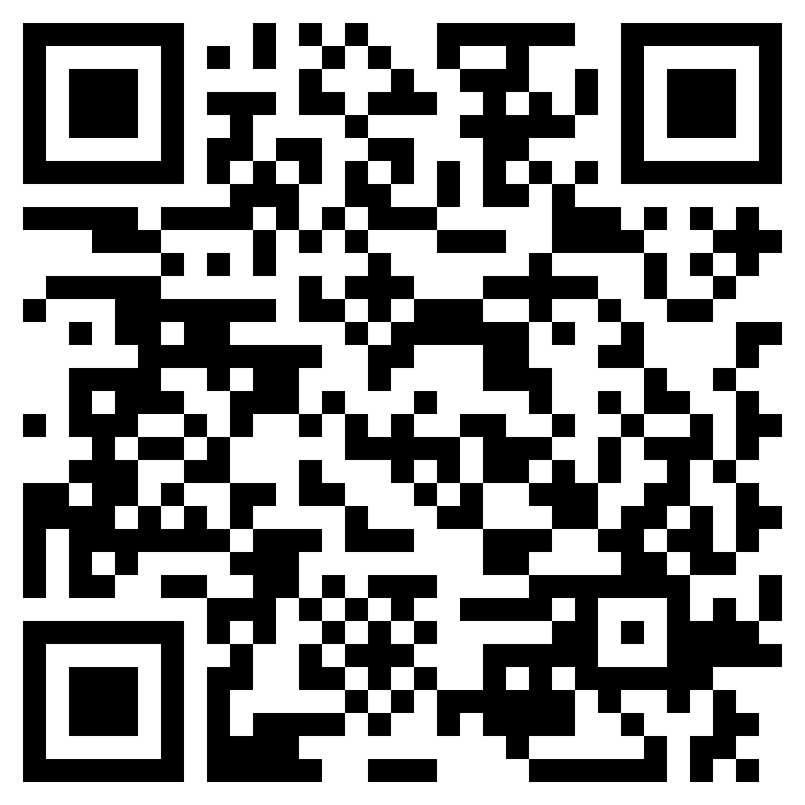
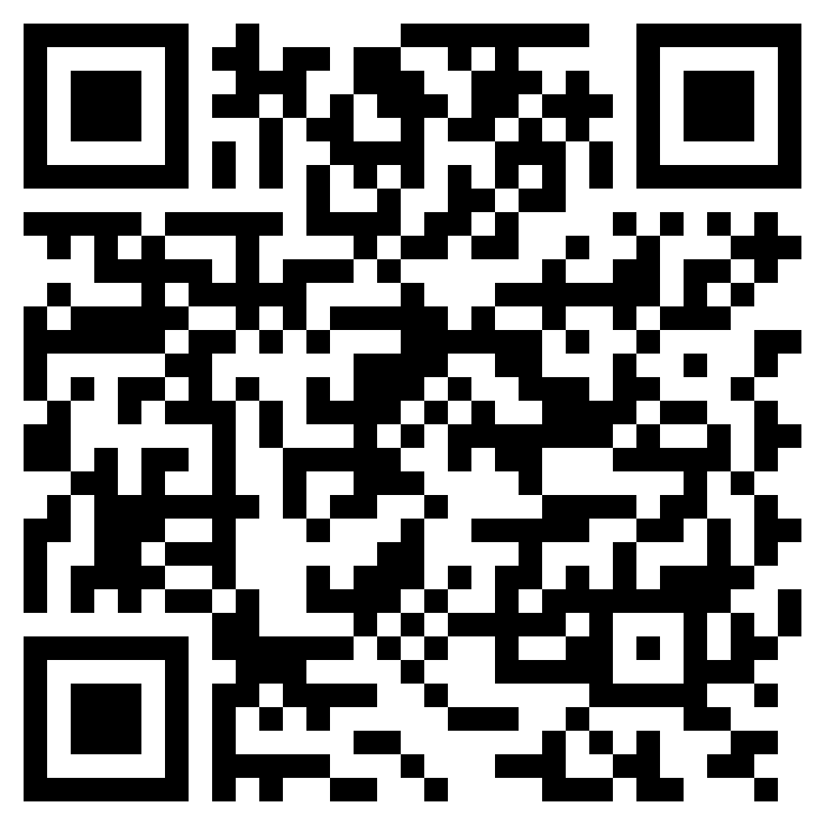
The Elevate Rewards program
Earn 2 reward points for every dollar of initial monthly premium collected.
Short Term Medical and Specified Care are excluded.
Points will be credited to your account next day (except Sundays).
Redeem points from a catalog of 900+ rewards…
Gift cards, merchandise, vacations/trips, cruises, sporting events, classes, and more.
Download the app and register.
Must accept Terms and Conditions to earn points for sales.
Earn 250 points for accepting Terms and Conditions. (Points will be credited to your account within 10 business days of completion.)
Watch for point multiplier bonus campaigns throughout the year.

Slide 3
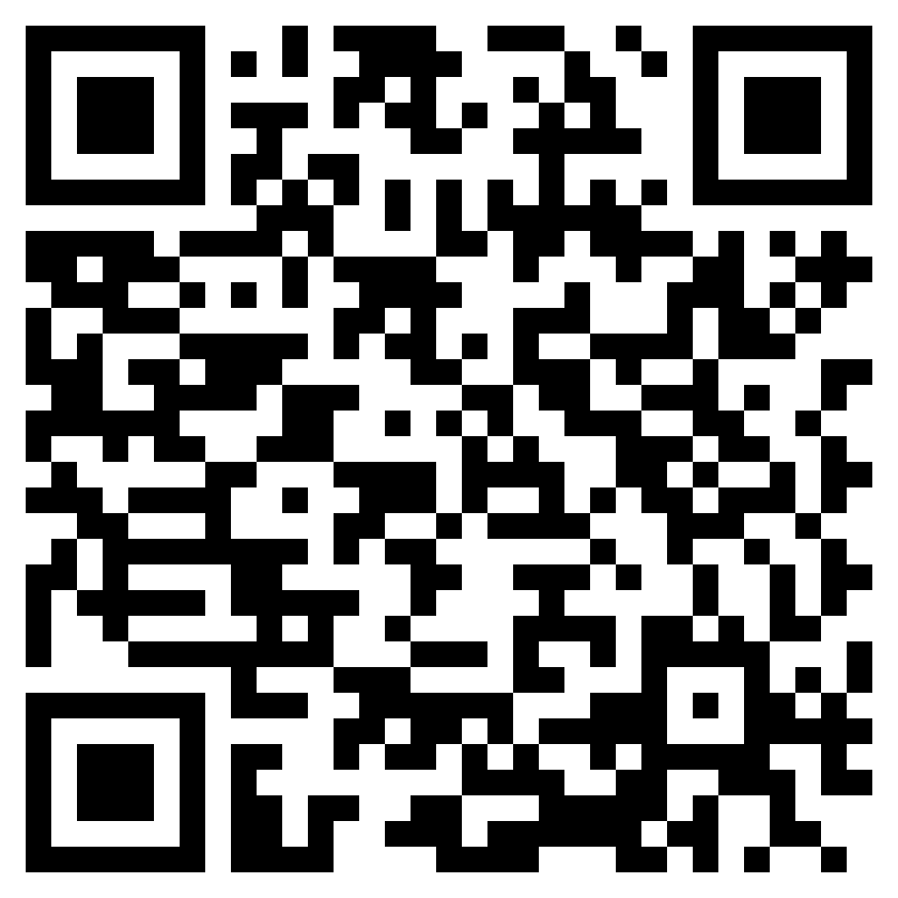
Accepting Terms and Conditions
Using the app
Using the website
Scan the QR code.
Open the app and click Forgot Password? on the login screen. Your user ID is your email with Allstate Health Solutions.
Check your email and set up a new password.
Log in to the app with your new password.
Click on My Profile, then My Account.
Scroll down and accept Terms and Conditions.
Scan the QR code.
Click Forgot your password? on the login screen. Your user ID is your email with Allstate Health Solutions.
Check your email and set up a new password.
Log in to the website with your new password.
Click on your initials in the top right corner.
Click on My Profile.
Click Change next to profile information.
Scroll down and accept Terms and Conditions.

Slide 4
Redeem points from a catalog of 900+ rewards…
Sell Allstate Health Solutions Individual Accident and Health products and watch your points add up.
Earn 2 reward points for every dollar of initial monthly premium collected.
Sell a $125 policy = 250 Elevate Rewards points, redeemable for a $10 gift card.
Sell a $300 policy = 600 Elevate Rewards points, redeemable for a $25 gift card.
Or save up your points for an even bigger reward!
Redeeming your points is easy. Here’s how:
Log in to the Elevate Rewards app or website.
Click on the Rewards tab.
Add reward to the basket and check out.
Choose from among 900+ catalog items:
Experiential rewards (vacations, cruises, events, and classes)*
Gift cards (restaurants, retail stores, etc.)
Merchandise (kitchen, jewelry, travel bags, etc.)
Electronics (cameras, tablets, headphones, etc.)
And much more…
*All vacations, cruises, events, and classes must be booked 90 days prior to scheduling date.

Slide 5
Elevate your earnings
Earn more points than ever with our points multiplier benefits. You’ll earn two points for every dollar of initial monthly premium collected (excluding Short Term Medical and Specified Care). Plus, every calendar year you can qualify for a higher rank and elevate your rewards. Lastly, you will never drop a rank from year to year.
Producers Club
Qualification: 2,000 points
Benefit: Earn 600 points, redeemable for a $25 gift card or save your points for a bigger catalog item.
Leaders Club
Qualification: 20,000 points
Benefit: Earn an additional 1% per qualifying sale.
Elite Club
Qualification: 40,000 points
Benefit: Earn an additional 2% per qualifying sale.
Executive Club
Qualification: 100,000 points
Benefit: Earn an additional 3% per qualifying sale.
Chairmans Club
Qualification: 225,000 points
Benefit: Earn an additional 4% per qualifying sale.

Slide 6
Any questions, please contact us at
ANHElevateRewards@ngic.com..
For agent use only. Not for distribution to consumers. Allstate Health Solutions is a marketing name for products underwritten by National Health Insurance Company, Integon National Insurance Company, Integon Indemnity Corporation and American Heritage Life Insurance Company. © 2024 Allstate Insurance Company. www.allstate.com or www.allstatehealth.com.

